Slide 1
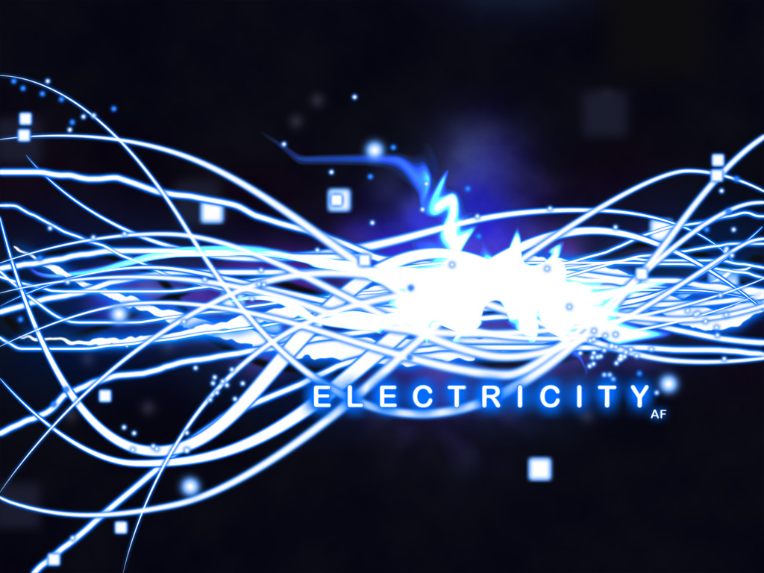
What Is
Electricity powers our world and our bodies. Harnessing its energy is both the domain of imagined sorcery and humdrum, everyday life -- from Emperor Palpatine to casting Luke Skywalker, to the simple act of ejecting the "Star Wars" disc from your PC. Despite our familiarity with its effects, many people fail to understand exactly what electricity is -- a ubiquitous form of energy resulting from the motion of charged particles, like electrons.

Slide 2
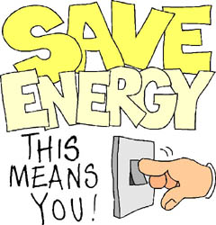

Slide 3
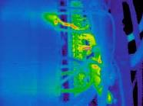
DANGERS OF ELECTRICITY
Staying safe around electricity is everyone's responsibility. You should watch out for yourself, your friends and your family.
Electricity is part of our everyday life - designed to provide us with a safe and reliable source of energy. Most of the time, electricity is our friend, but sometimes it can be dangerous. This happens when we're exposed to it in ways we were not meant to be. We can avoid these hazards by following some simple rules.

Slide 4
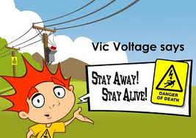

Slide 5

Working Safely with Electricity
Working with electricity can be dangerous. Engineers, linemen, electricians, and others work with electricity directly, including overhead lines, cable harnesses, and circuit assemblies. Office workers and salespeople work with electricity indirectly and may also be exposed to electrical hazards.

Slide 6
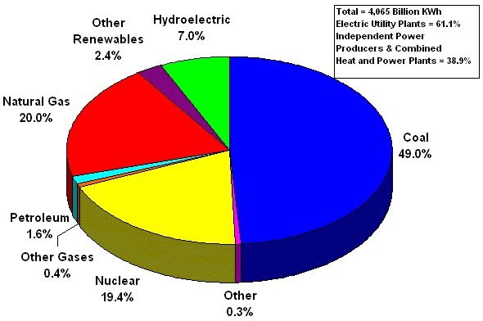

Slide 7
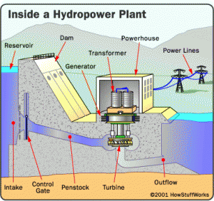

Slide 8
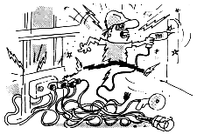
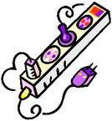
Generators
One of the common tools utilized following the loss of power are portable generators. Most generators are gasoline powered and use internal combustion engines to produce electricity. Carbon monoxide is a colorless and odorless gas produced during the operation of gasoline powered generators. When inhaled, the gas reduces your ability to utilize oxygen. Symptoms of carbon monoxide poisoning include headache, nausea and tiredness that can lead to unconsciousness and ultimately prove fatal.
  DO NOT bring a generator indoors. Be sure it is located outdoors in a location where the exhaust gases cannot enter a home or building. Good ventilation is the key.
  Be sure that the main circuit breaker is OFF and locked out prior to starting any generator. This will prevent inadvertent energization of power lines from back feed electrical energy from generators and help protect utility line workers from possible electrocution.
  Turn off generators and let them cool prior to refueling.

Slide 9
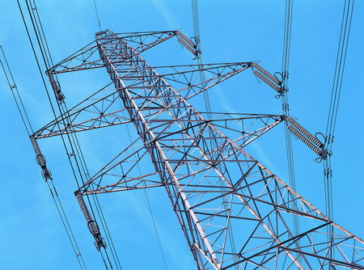
Power Lines
Overhead and buried power lines are especially hazardous because they carry extremely high voltage. Fatal electrocution is the main risk, but burns and fall are also hazards.
Look for overhead power lines and buried power line indicators. Stay at least 10 feet away from overhead power lines and assume they are energized.
De-energize and ground lines when working near them.
Use non-conductive wood or fiberglass ladders when working near power lines.

Slide 10
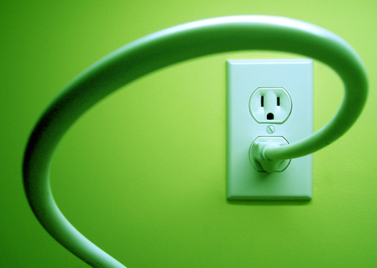
Extension Cords
Normal wear on cords can loosen or expose wires. Cords that are not 3-wire type, not designed for hard-usage, or that have been modified, increase your risk of contacting electrical current.
Use only equipment that is approved to meet OSHA standards.
Do not modify cords or use them incorrectly.
Use factory-assembled cord sets and only extension cords that are 3-wire type.
Use only cords, connection devices, and fittings that are equipped with strain relief.
Remove cords from receptacles by pulling on the plugs, not the cords.

Slide 11

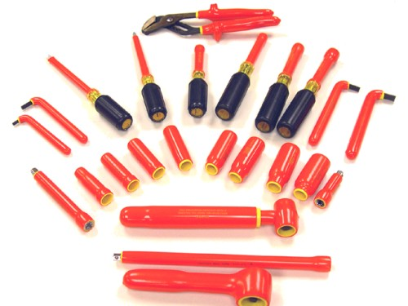
Equipment
Due to the dynamic, rugged nature of construction work, normal use of electrical equipment causes wear and tear that results in insulation breaks, short-circuits, and exposed wires. If there is no ground-fault protection, it can cause a ground-fault that sends current through the worker's body.
Use ground-fault circuit interrupters (GFCIS) on all 120-volt, single-phase, 15- and 20-ampere receptacles, or have an assured equipment grounding conductor program (AEGCP).
Use double-insulated tools and equipment, distinctively marked.
Visually inspect all electrical equipment before use. Remove from service any equipment with frayed cords, missing ground prongs, cracked tool casings, etc.

Slide 12
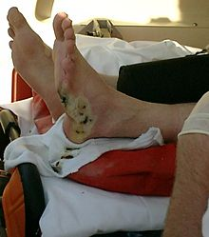
Electrical Incidents
If the power supply to the electrical equipment is not grounded or the path has been broken, fault current may travel through a worker's body, causing electrical burns or death. Even when the power system is properly grounded, electrical equipment can instantly change from safe to hazardous because of extreme conditions and rough treatment. Visually inspect electrical equipment before use. Take any defective equipment out of service. Ground all power supply systems, electrical circuits, and electrical equipment. Frequently inspect electrical systems to insure that the path to ground is continuous.
Do not remove ground prongs from cord- and plug-connected equipment or extension cords. Use double-insulated tools and ground all exposed metal parts of equipment. Avoid standing in wet areas when using portable electrical power tools.

Slide 13
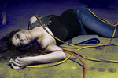
Shock-hazard analysis
Hundreds of workers are killed every year as a result of inadvertent contact with energized conductors. Investigations into the causes of these fatalities point to three principal factors: Failure to properly or completely de-energize systems prior to maintenance or repair work Intentionally working on energized equipment Improper or inadequate grounding of electrical system components These three factors form the basis for analysis for the electrical shock hazard
To appropriately assess the electrical shock hazard associated with any type of maintenance or repair work, it is necessary to evaluate the procedures or work practices involved. These, in turn, should be evaluated against regulatory and standards requirements.

Slide 14
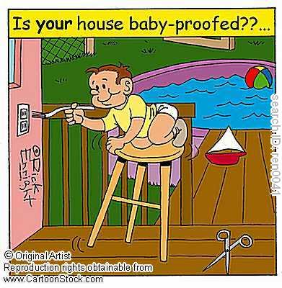

Slide 15
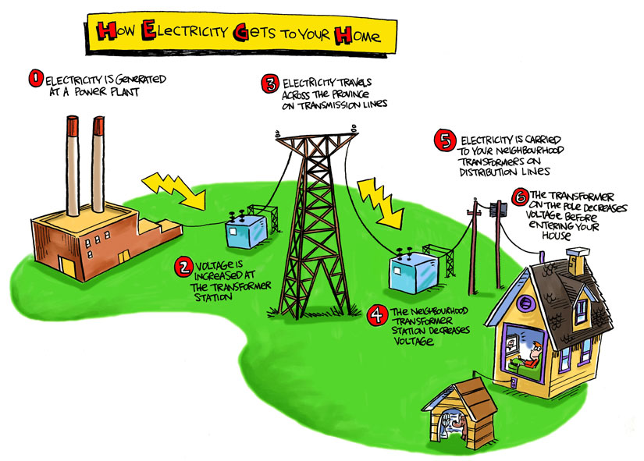

Slide 16
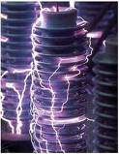
What affects the flow of electricity?
Electricity flows more easily through some materials than others. Some substances such as metals generally offer very little resistance to the flow of electric current and are called “conductors.” A common but perhaps overlooked conductor is the surface or subsurface of the earth. Glass, plastic, porcelain, clay, pottery, dry wood, and similar substances generally slow or stop the flow of electricity. They are called “insulators.” Even air, normally an insulator, can become a conductor, as occurs during an arc or lightning stroke.

Slide 17
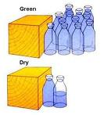

How does water affect the flow of electricity?
Pure water is a poor conductor. But small amounts of impurities in water like salt, acid, solvents, or other materials can turn water itself and substances that generally act as insulators into conductors or better conductors.
Dry wood, for example, generally slows or stops the flow of electricity. But when saturated with water, wood turns into a conductor.
The same is true of human skin. Dry skin has a fairly high resistance to electric current. But when skin is moist or wet, it acts as a conductor.
This means that anyone working with electricity in a damp or wet environment needs to exercise extra caution to prevent electrical hazards.

Slide 18
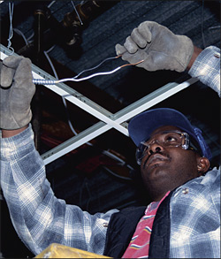
What is the best way to protect yourself against electrical hazards?
Most electrical accidents result from one of the following three factors:
  unsafe equipment or installation, unsafe environment, or unsafe work practices.
Some ways to prevent these accidents are through the use of insulation, guarding, grounding, electrical protective devices, and safe work practices.

Slide 19
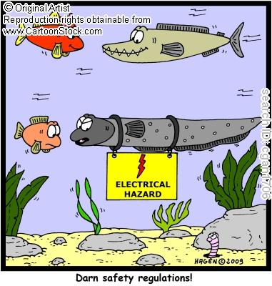

Slide 20
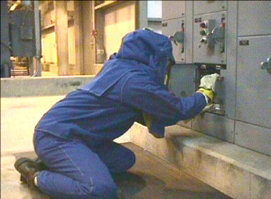
What protection does personal equipment offer?
Employees who work directly with electricity should use the personal protective equipment required for the jobs they perform.
This equipment may include:
  rubber insulating gloves, hoods, sleeves, matting, blankets, line hose, and industrial protective helmets designed to reduce electric shock hazard.
All help reduce the risk of electrical accidents.

Slide 21
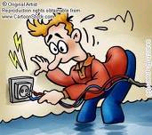
Electricity and water do not mix
Remember
If your hands tingle when you put them into the sink it may mean the water is conducting electricity and something is wrong. You may need to call an electrician.
When you have a bath, there should be nothing electrical anywhere near you. In a bath, the metal plughole and the plumbing is connected to the earth, making it a conductor of electricity. This means if a household appliance such as a light or hair dryer fell into the bath, whoever was in it would also become a conductor of electricity.
Wherever you are, if you get into trouble call out for help and make sure not to touch anything. Get whoever helps you to turn the electricity off.
Water can conduct electricity because electrons can flow by hitching a ride on atoms and molecules in the water. Water contains dissolved substances, such as salt. These greatly increase the ability of water to conduct electricity. That's why electricity passes easily through our bodies - because our bodies contain water and salt. This is also why it's important to keep water away from electrical appliances.

Slide 22
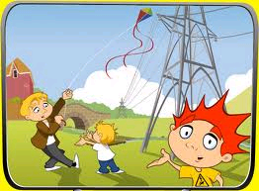
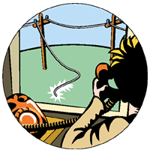
Be careful around electricity poles and wire.
If you fly a kite and it gets caught in the overhead power lines, live electricity could travel down the string and seriously hurt you. So be careful!
Never climb a tree that is near power lines. Look up before you climb!
After a storm if you see some fallen power lines, stay well clear of them. There is a strong chance they are still "alive". We all like to play outside, but there are electrical hazards that we need to know about. Electricity poles and wires are all around us. They can be above us, next to us, and even below us. Whenever you can, play in open spaces away from electricity poles, towers and power lines.

Slide 23
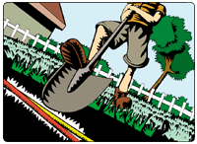
DIAL BEFORE YOU DIG!
Remember
Before you or your family do any major digging in the yard, you should Dial 1100 to make sure there are no underground cables near your property. If you hit a buried power line you could be electrocuted, as well as possibly interrupting the power to your suburb.

Slide 24
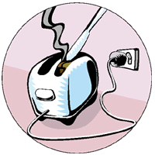
Metal is a conductor of electricity and can be dangerous
Remember
Never put a metal object - like a knife - into a toaster. It is very dangerous!
Never put anything in a power point that's not meant for it. Electricity will travel right up the metal object into your body.
Be careful when climbing a ladder at home. The power lines connected to our house are usually protected, but they can be damaged by rubbing against the gutter or a tree, or through exposure to the sun.
If a person is on a metal ladder and touches the exposed line, the electricity will travel through their body to the earth. We all come into contact with metal objects on a daily basis - turning on a tap, playing with our computers and toys and even using the fridge. Because metal conducts electricity, you have to be very careful when you use metal items.

Slide 25
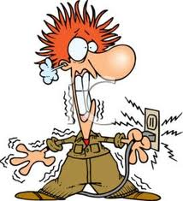
Working with electricity
The three major accident risks when working with electricity are electrocution, falling off ladders and fire/explosions. Of these the most common is electrocution. The great majority of electrical accidents occur as a result of contact with alternating current, usually at 50 Hz.
"Electric shock" is a result of electric current flowing through the body's nerves, muscles and organs causing disturbances to normal body functions. The heart's rhythm may be disturbed and this can stop the blood flowing to the brain, which can lead to death. Quick action is often required by artificial respiration and cardiac massage to return the heart to its correct rhythm.

Slide 26
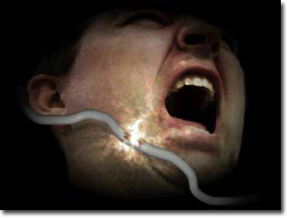
The real measure of an "electric shock" lies in the amount of current (amperes) forced through the body.
1 to 3 mA Can be felt
3 to 10 mA Tingling, heat and pain
10 to 15 mA Muscles contract. Hard or impossible to let go of conductor
25 to 30 mA Chest muscles contract, unable to breathe
50 to 250 mA Ventricular fibrillation (an uncoordinated twitching of the walls of the heart's ventricles)
5 A and above mA Heart muscles clamp, pumping action ceases entirely. Tissue burns
Current magnitude depends on applied voltage and the electrical resistance of the current path. The electrical resistance of the human body can vary from person to person and in the same person vary at different times and under different conditions. This resistance can be as high as 10,000 or as low as 100-200 ohms depending largely on whether the skin is dry or wet. Even at the highest value of resistance, contact with a 240-V supply will result in a current which could be lethal.
Accidents with direct current are not as high as would be expected from the number of direct current applications. This is partly due to the fact that with direct current it is easier to let go of a conductor than with alternating current. The main differences between the effects of a.c. and d.c. on the human body is that to produce the same excitatory effects the magnitude of direct current flow of constant strength is 2-4 times greater that that of alternating current.

Slide 27
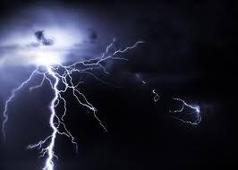
Typical electrical hazards on work sites include:
  voltages between phases
  voltages between phases and neutral
  voltage between phases and earth
  voltages between live conductors and surrounding metal framework
  voltages across un-discharged capacitors
  voltages on disconnected conductors, particularly neutrals (induced voltages)
  faulty fittings and equipment
  long extension cords
  linking a number of short cords to make one long one
  relying on motor starters and single pole switches for isolation
  using metal ladders
  power cords tied in knots
  using tools without insulated handles - plastic can become charged
  working near overhead lines - electricity can flash to objects within 10-15m of lines
  working on live equipment

Slide 28
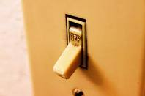
The most common feature of electrical accidents
Is the presence of live parts or live conductors in the work area. To eliminate the hazard of shock or burns:
  switch off the supply
  isolate and tag the supply
  prove the supply is dead by testing it with an approved testing instrument
Wherever practicable disconnect or isolate and tag the power before working on equipment.
Stay alive by working dead!

Slide 29

What are the most common dangers of electricity?
The electricity in your home is dangerous. Many people have had an electric shock at some time or another without lasting injury but this does not show immunity, merely the unpredictable nature of electricity shocks. Slightly different circumstances could have resulted in death. It can easily kill people especially if you are young, old or sick. This is why all the wiring in a house has different forms of protection and is generally built into the walls, ceilings and floors.
  If you put something metal in a socket it could give you an electric shock.
  Keep water and drinks away from electricity and never take electricity into the bathroom. If you have wet hands you should not touch electricity, you should wipe your hands because you could get an electric shock.
  Do not let leads from electrical wires drag across the floor.
  If you leave a light bulb on you can burn yourself because it can be very hot.
  Do not put flammable materials on hot things as they could burn.
  Never leave fire by electrical items.
  Batteries are less dangerous than using plugs.
  If you plug too many plugs just in one socket then it may get over heated and catch fire.

Slide 30
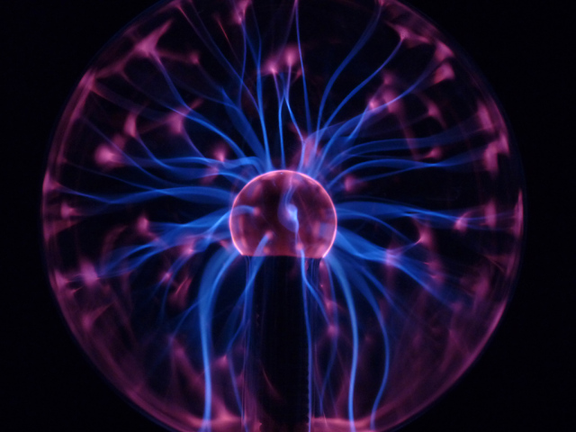
Electrical safety regulations and standards
The first key to electrical safety is to understand and follow safety regulations and standards. OSHA is the “law of the land” for electrical safety regulations. The OSHA Act of 1970 requires employers to provide employees with a workplace that is free from recognized hazards that could cause death or serious physical harm. Although not specifically stated, hazards such as electrical shock, arc flash, and arc blast would apply. Subpart S of OSHA 29 CFR Part 1910 “Standards for General Industry” contains electrical safety requirements that deal with protection from electrical hazards.
Because of these electrical hazards, the general rule of thumb is to not work hot. OSHA 1910.333(a)(1), requires live parts to be de-energized before an employee works on or near them unless de-energizing introduces additional or increased hazards or is infeasible due to equipment design or operational limitations. It’s important to understand that financial, convenience, or production concerns aren’t acceptable reasons to work on equipment hot. Failure to follow this OSHA requirement is a violation of federal law and can result in fines and/or criminal indictment.
Part II 2-1.1.1 of NFPA 70E-2000 “Standard for Electrical Safety Requirements for Employee Workplaces” has similar requirements. One difference, however, is that it uses the phrase “electrically safe work condition” instead of “de-energized.” It defines an electrically safe work condition as a state in which the conductor or circuit part to be worked on or near has been disconnected from energized parts, locked/tagged in accordance with established standards, tested to ensure the absence of voltage, and grounded if determined necessary. Part II 2-1.1.3 of the standard details the process for achieving an electrically safe work condition.

Slide 31
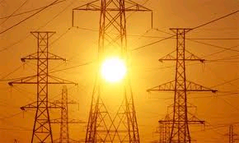
Electrical safety program
The second key electrical safety principle is to establish and follow an electrical safety program, which is the employer’s responsibility. The electrical safety program must be well thought-out, documented, and most importantly, put into practice. To develop an effective electrical safety program, all levels of personnel at a company or facility must be involved and committed to the program.
An essential part of any electrical safety program is training. OSHA 1910.332(b)(1) requires training for electrical safety-related work practices. This requirement is valid for both qualified and unqualified persons, and the level of training is based upon their respective job assignments. Similar to OSHA, NFPA 70E-2000 Part II 1-5 details electrical safety training requirements for qualified and unqualified persons.
NFPA 70E-2000 details other important requirements for an electrical safety program in Part II 2-3, including the following:
    Awareness of electrical hazards and self-discipline of employees.
    Identification of hazard/risk evaluation procedures.
    Identification of electrically safe work procedures, tools, and personal protective equipment.
    Identification of electrical safety principals, one of which is safety by design.

Slide 32
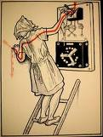
Electrical hazards
Understanding and identifying shock, arc flash, and arc blast is the third key electrical safety principle. An arc fault is initiated by current passing between two conducting metals through ionized gas or vapor caused by a flashover or other conductive material, such as a screwdriver. When an arc fault occurs, it produces an explosion with a significant amount of destructive energy.

Slide 33
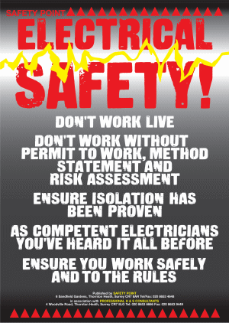

Slide 34
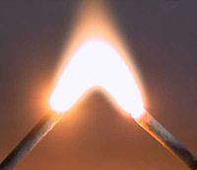
The electrical arc produces temperatures that can exceed 35,000°F
This extreme temperature melts and vaporizes copper, which has an expansion ratio from solid to vapor of 67,000, as well as other materials. The high heat, arc flash, and molten metal can ignite clothing and cause fatal burns as far as 10 ft away. The vaporization and expansion of copper cause the arc blast itself and the hot rapid-air expansion produces the immense sound and pressure waves as well as shrapnel. Pressure waves can rupture eardrums, collapse lungs, and propel workers across the room or cause them to fall from ladders. All of this occurs in a fraction of a second and will continue until the over current protective device operates.

Slide 35
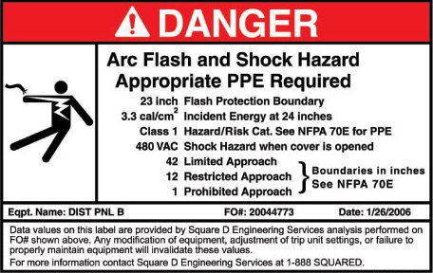

Slide 36
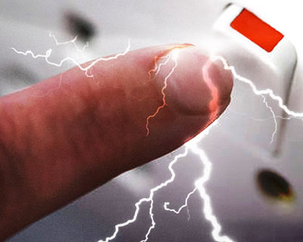
To better
Warn employees of electrical arc flash hazards, 110.16 of the 2002 NEC now requires labeling for equipment likely to require examination, adjustment, servicing, or maintenance while energized. The labeling, which should be placed on both new and existing equipment, should warn of the potential arc flash hazards and the requirement for PPE. It should identify flash hazard analysis information, such as the flash protection boundary, incident energy and required PPE

Slide 37

Work procedures, tools, and PPE
The fourth key electrical safety principal is to use safe work procedures, tools, and PPE.
  Electrical work must be planned before it is executed.
  All work procedures should be reviewed, updated, improved, and modified periodically as needed.
  For non-hazardous electrical work—equipment in an electrically safe work condition—the plan is typically unwritten but may be part of a general checklist and/or job briefing.
  For hazardous electrical work—energized or potentially energized equipment—a written procedure is usually required with documentation including a hazard/risk analysis detailing shock approach boundaries, flash hazard analysis, and a checklist of tasks.
OSHA 1910.333 covers the requirements for selection and use of work practices. The general requirement per OSHA 1910.333(a) is: “Safety-related work practices shall be employed to prevent electric shock or other injuries resulting from either direct or indirect electrical contacts, when work is performed near or on equipment or circuits which are or may be energized. The specific safety-related work practices shall be consistent with the nature and extent of the associated electrical hazards.”
The requirements for insulated tools, safeguards, and various types of personal protective equipment are detailed in OSHA 1910.335 and NFPA 70E-2000 Part II Chapter 3.

Slide 38
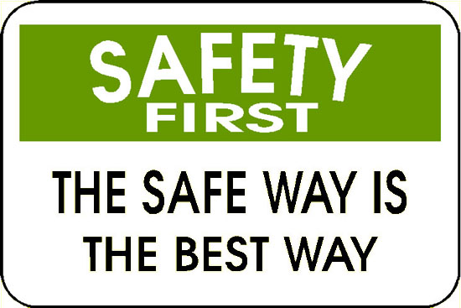
Safety by design
The final electrical safety principal is to increase electrical safety by design. One of the design considerations for electrical safety is to isolate the circuit. The use of isolation equipment to support preventive maintenance and repair for proper implementation of lockout/tagout procedures is an essential provision for electrical safety. This is especially important for motor loads and other loads that may require isolation for maintenance or repair purposes.

Slide 39
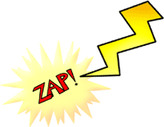
The key
The key electrical safety principles focus on the protection of owners, employers, and employees. To ensure a safer workplace, electrical professionals must change their existing cultures, beliefs and practices and follow electrical safety standards and regulations. By understanding electrical safety standards and regulations, establishing and following an electrical safety program, understanding and identifying electrical hazards, using safe work procedures, tools, and protective equipment, and improving electrical system safety by design, the electrical industry can work in a safer environment.
ELECTRICITY

Slide 40
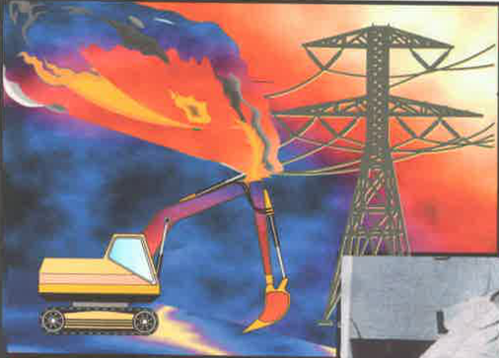
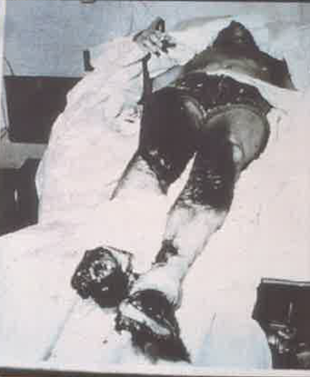
BEGIN
INSTRUCTION
ZONE
ELECTRICAL HAZARDS
1
ROADWAY SAFETY
What are the dangers of Electricity?
Contact can cause explosion, fire, electrocution.
On the worksite
Equipment contacting a live electrical line can cause fire, explosion, or electrocution.
Electricity can arc from the line to the equipment.
Electricity can cause severe burn and death.
Work around electricity only
When you are trained in all aspects of the job.
When you have reason to be there.

Slide 41
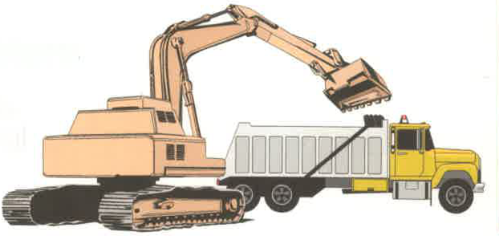
2
BEGIN
INSTRUCTION
ZONE
ELECTRICAL HAZARDS
ROADWAY SAFETY
How Do We treat Above-Ground Utilities?
Use extreme caution and keep your distance.
When working around a power line
Get the utility company to mark, flag, and shield lines.
Assume it is live until tested, have it de-energized and visibly grounded.
If it must remain energized, keep equipment and load at least 10 foot
away and use a spotter to warn the operator.
Post a signs at ground level to mark safe distance.
Make all workers and drivers who must enter the
area aware of the overhead lines.
Danger
Overhead
Power
Line
MINIMUM SAFE DISTANCE POWER LINES
VOLTAGE | DISTANCE
50 kV OR BELOW | 10
>50 – 200 kV | 15
>200 – 350 kV | 20
>350 – 500 kV | 25
>500 – 750 kV | 35
>750 – 1,000 kV | 45
More in fog or rain
Tips for operators
Mark a safe route
for repeated travel
Slow down

Slide 42
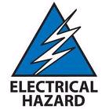
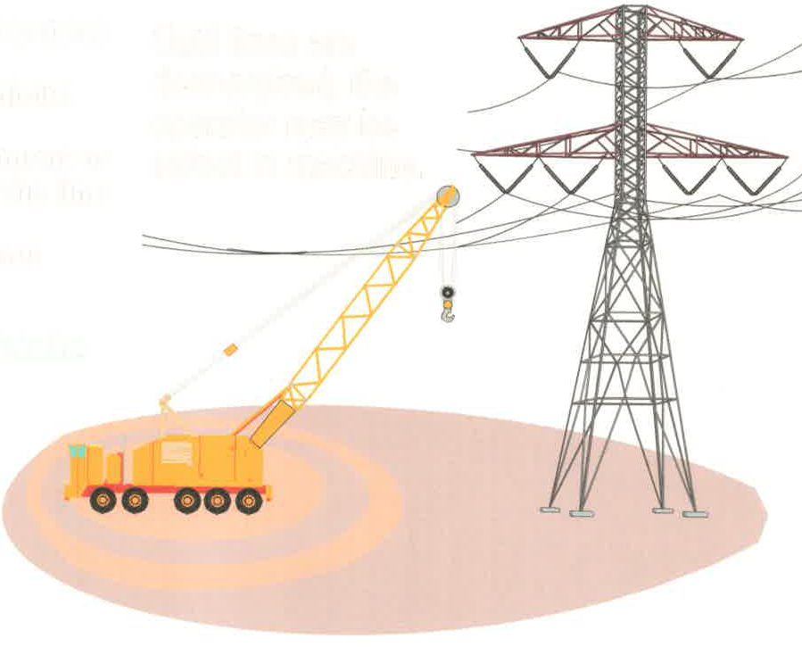
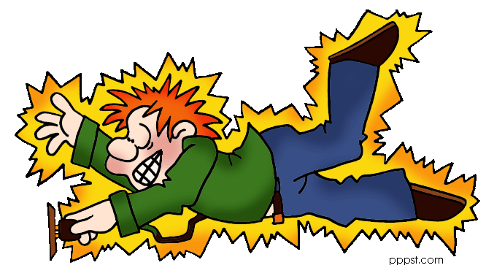
What If Contact Happens?
Do not touch equipment or person in contact
3
BEGIN
INSTRUCTION
ZONE
ELECTRICAL HAZARDS
ROADWAY SAFETY
If you are on the ground
  Stay away from the vehicle!
  Do not touch and equipment or person in contact with the line.
  Get the line de-energized.
If you are in the vehicle
  Stay in the vehicle and do not touch any metal.
  If you must get out, jump clear, then shuffle slowly away.
Until lines are de-energized,
The operator may be safest
In the machine.

Slide 43
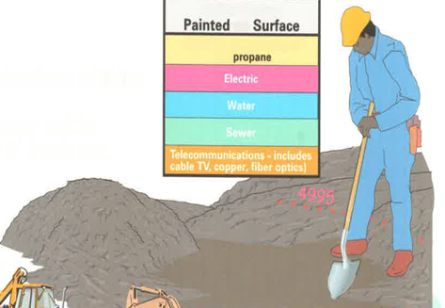
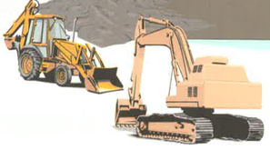
Can We Be Safe Around Buried Utilities?
Contact can cause explosion, fire, electrocution
BEGIN
INSTRUCTION
ZONE
ELECTRICAL HAZARDS
ROADWAY SAFETY
Before digging
Call electrical, gas, and communication utilities.
Review marked out areas. They may not be exact. Dig by hand within 2 feet of mark-out.
When digging, looks for:
Signs of previous digging:
Changes or depressions,
concrete, or gravel.
If a line is hit, you must report it. If is a gas line, evacuate and secure area, call fire department.

Slide 44
